Slide 1
INTEL (Intel Unnati Industrial Training 2025)

Slide 2
Abstract
The Educational AI Assistant is a smart, multimodal system that can understand and respond to queries in the form of text, voice, or image.
It uses optimized AI models to process inputs in real time, making it useful for dynamic learning environments.
OpenVINO helps reduce the computational load, allowing the system to run efficiently on devices without high-end GPUs.
The assistant is suitable for use in classrooms where only basic desktop or laptop systems are available.

Slide 3
Educational AI Assistant with OpenVino
Introduction :
Artificial Intelligence is increasingly being integrated into the education sector to support smarter and more personalized learning.
Traditional classroom settings do not always allow for individual attention, especially in large groups.
This AI assistant fills that gap by acting as a digital tutor that is available to answer questions at any time.
It accepts natural queries through typing, speaking, or uploading content, which improves accessibility for different learning styles.

Slide 4
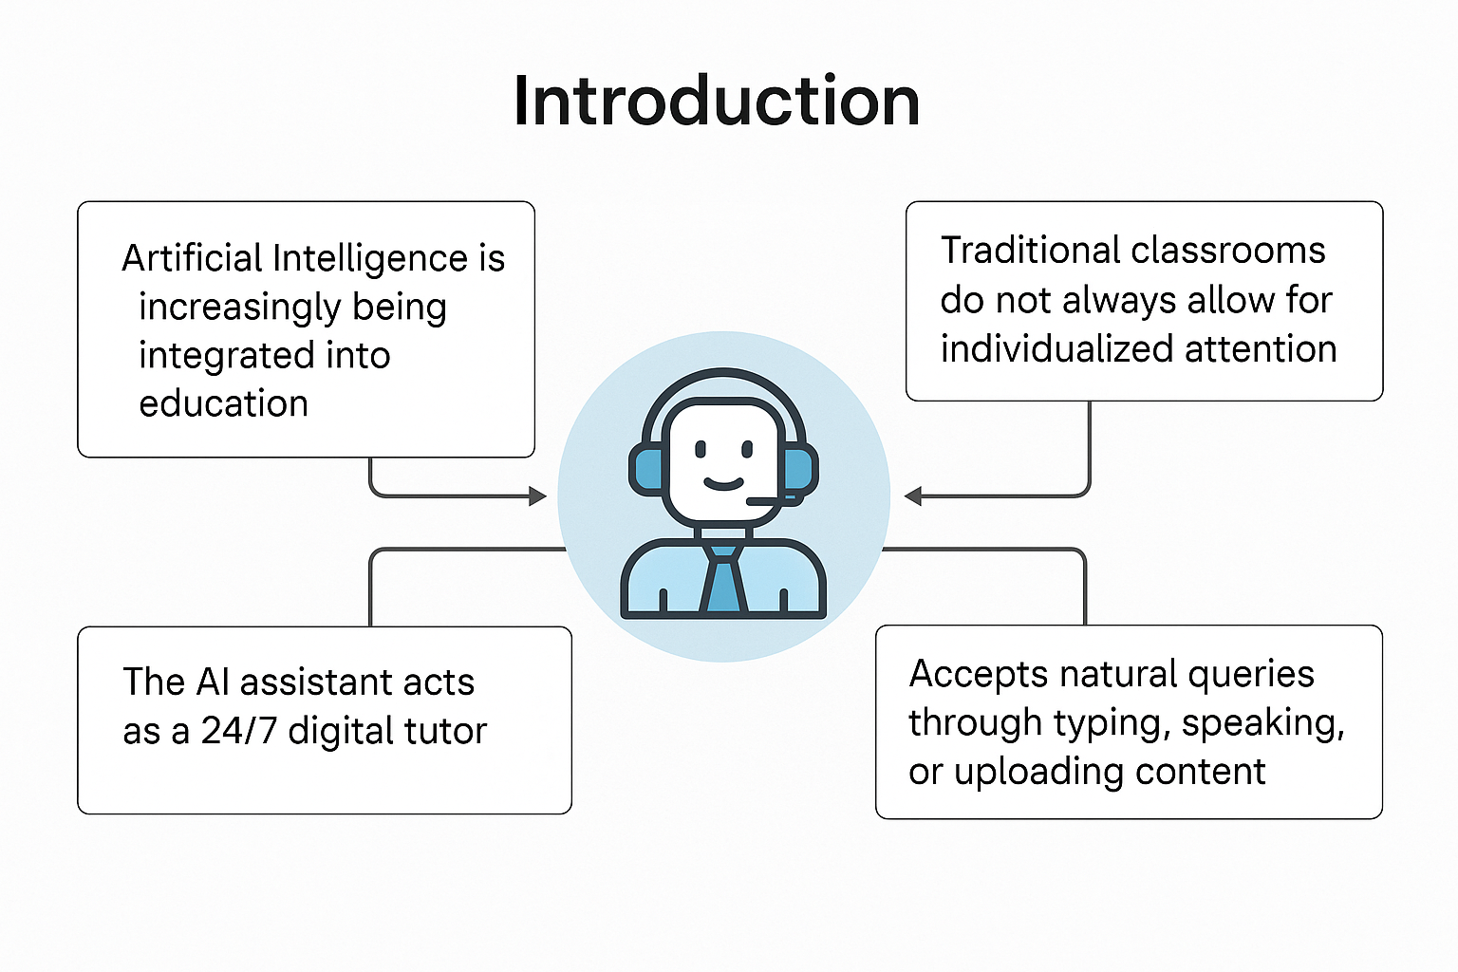
Educational AI Assistant with OpenVino
The system enhances teacher-student interactions while reducing repetitive workload on instructors.

Slide 5
Educational AI Assistant with OpenVino
Objectives :
The project aims to develop a user-friendly assistant that can assist students in real time during their studies.
It supports inputs in three modes: typed text, voice-based questions, and image uploads such as textbook photos or notes.
The backend is designed using Flask to manage API routes and request handling efficiently.
All AI models are optimized using Intel’s OpenVINO toolkit to ensure fast response times without GPU dependency.

Slide 6
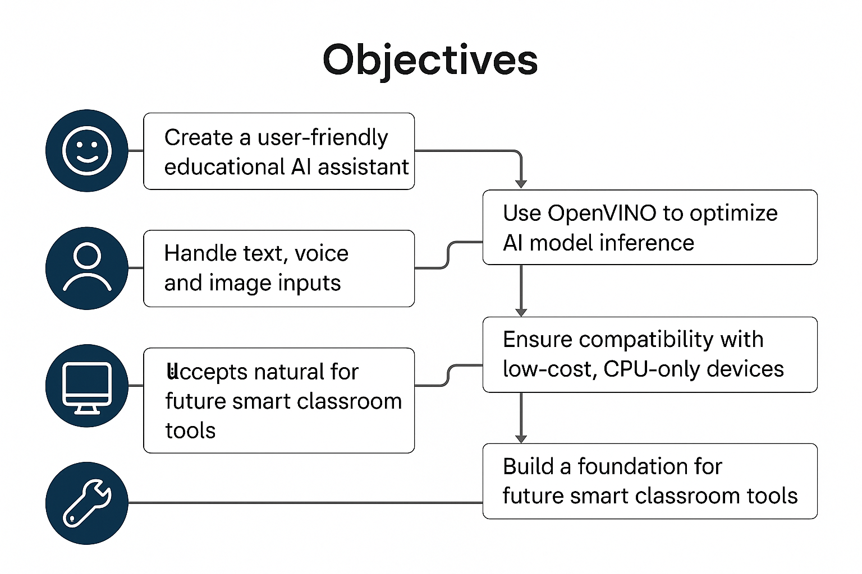
Educational AI Assistant with OpenVino
The solution is intended to work on low-cost devices, including regular classroom PCs and laptops.
Future enhancements like emotion detection and multilingual support are also considered in the system's design.

Slide 7
Educational AI Assistant with OpenVino
System Architecture :
The system architecture includes a frontend interface built using React, which serves as the user interaction layer.
A Flask-based backend is responsible for routing the inputs to the appropriate AI model depending on the input type.
When a user types a question, it is processed by a language model such as Phi-2 for answer generation.
When a user uploads an image, it is processed by an OCR engine like Tesseract to extract text.

Slide 8
Educational AI Assistant with OpenVino
If a user speaks a query, the voice input is transcribed using Google’s SpeechRecognition API.
The output is then passed back to the user through the frontend, completing the interaction loop.
OpenVINO ensures that all model inferences happen quickly and efficiently on CPU-based machines.

Slide 9
Educational AI Assistant with OpenVino
Module Breakdown :
app.py is the main Python file that runs the Flask server and handles routes for text, voice, and OCR queries.
model_utils.py loads the OpenVINO-optimized models and handles inference logic for each supported task.
The uploads/ folder is used to store temporary files like uploaded images or audio clips.
All optimized models are stored in the models/ directory in OpenVINO’s Intermediate Representation (IR) format.

Slide 10
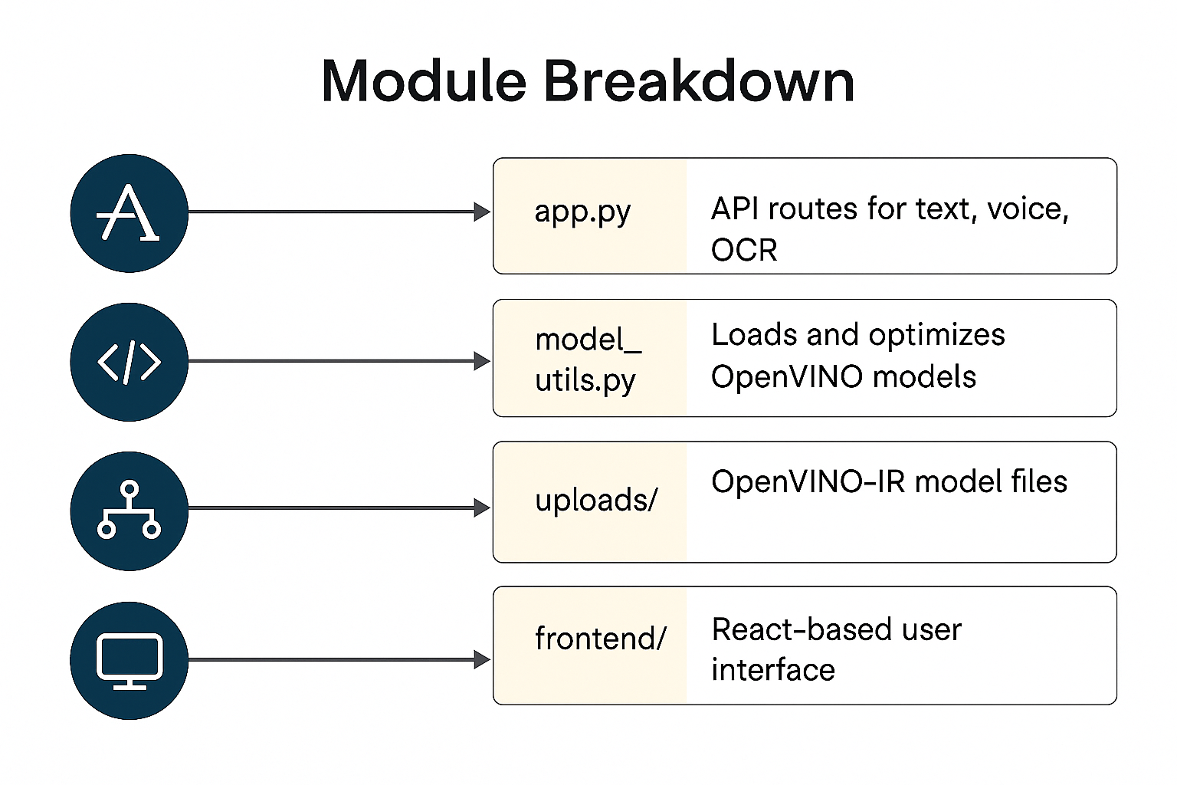
Educational AI Assistant with OpenVino
The frontend/ folder contains the React-based user interface for chat, file uploads, and microphone input.
All software dependencies required to run the system are listed in requirements.txt.

Slide 11
Educational AI Assistant with OpenVino
AI Models Used :
For natural language question answering, the assistant uses the Phi-2 model from Microsoft, optimized using OpenVINO.
Tesseract OCR is used to extract text from image inputs, such as textbook pages or handwritten notes.
The Google SpeechRecognition API is used to transcribe spoken queries into text.
BLIP-2 is an optional model considered for future versions, which will handle visual question answering and image captioning.

Slide 12
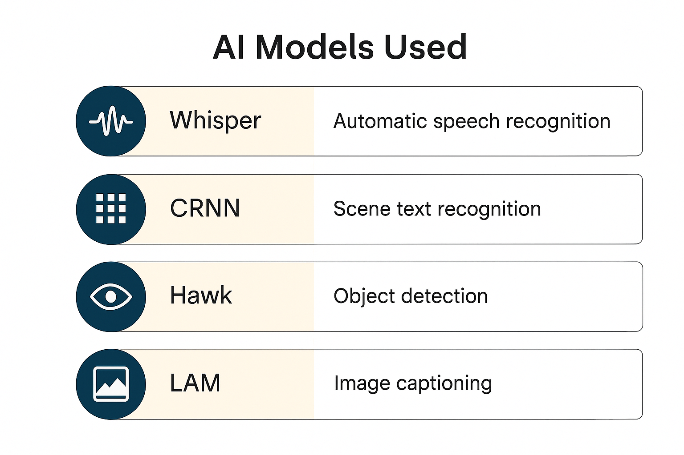
Educational AI Assistant with OpenVino
OpenVINO optimization allows these models to run smoothly on regular CPUs by reducing inference time.

Slide 13
Educational AI Assistant with Open Vino
Use Cases :
A student can type a question like “What is photosynthesis?” and get an immediate answer from the assistant.
If a student prefers to speak, they can use the microphone to ask a question, which is transcribed and answered.
Students can upload a photo of a book page or classroom notes, and the assistant will extract the text and provide explanations.
In future versions, the assistant will be able to interpret labeled diagrams and answer related questions using visual models.

Slide 14
Educational AI Assistant with OpenVino
Performance Expectations :
The assistant is expected to respond to text-based questions in under two seconds on an average CPU system.
Voice input should be transcribed and answered within three seconds to maintain user engagement.
The OCR module achieves around 90% accuracy when processing clean, printed images.
Each AI model, once optimized using OpenVINO, occupies less than 1 GB of storage space.

Slide 15
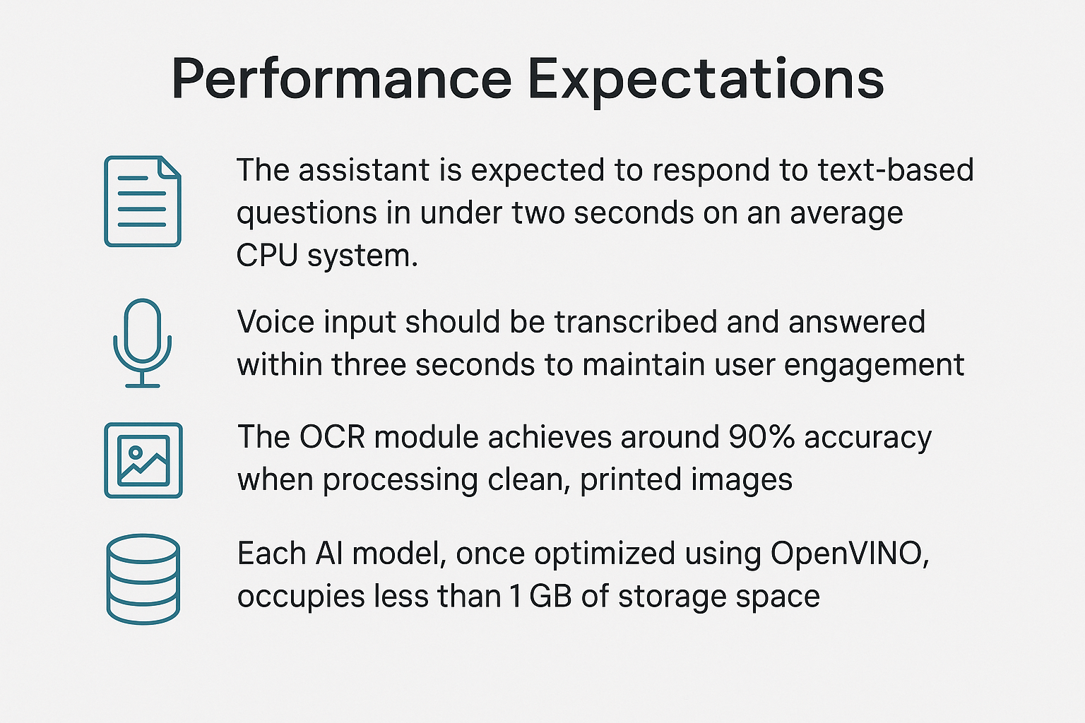
Educational AI Assistant with OpenVino
These performance levels make the assistant suitable for classroom computers and low-power devices.

Slide 16
Educational AI Assistant with OpenVino
Future Enhancements :
The assistant will be enhanced to include webcam-based emotion and engagement detection to monitor students’ focus levels.
Real-time transcription of classroom lectures will be introduced to help students automatically capture notes.
Regional language support for Hindi, Tamil, Kannada, and other Indian languages will be added for inclusivity.
A feedback system will be developed to allow students to rate the helpfulness of answers and view previous chats.

Slide 17
Educational AI Assistant with Open Vino
Summary :
This project brings together Natural Language Processing, Speech Recognition, and Computer Vision into one assistant.
The use of OpenVINO ensures that AI models run with minimal latency even on standard classroom hardware.
The system provides a smart, responsive, and inclusive learning experience for students.
Teachers benefit by reducing their workload and focusing more on higher-level student needs.
The Educational AI Assistant is a powerful example of how optimized AI can be used in real-world educational settings.

Slide 18
Educational AI Assistant with OpenVino
References :
OpenVINO Documentation: https://docs.openvino.ai/latest/index.html
Microsoft Phi-2 Model Card: https://huggingface.co/microsoft/phi-2
Tesseract OCR GitHub: https://github.com/tesseract-ocr/tesseract
Google SpeechRecognition API: https://pypi.org/project/SpeechRecognition/
BLIP-2 on HuggingFace: https://huggingface.co/docs/transformers/model_doc/blip

Slide 19
Thank You

